Slide 1

AI Tweet Verification System
(Fake vs Real Tweet Detection using Machine Learning)

Slide 2
TEAM Members:
Hafsa Sheikh, Alina Ali, and Muhammad Suleiman
Supervisor:
                Ma’am Muniza

Slide 3
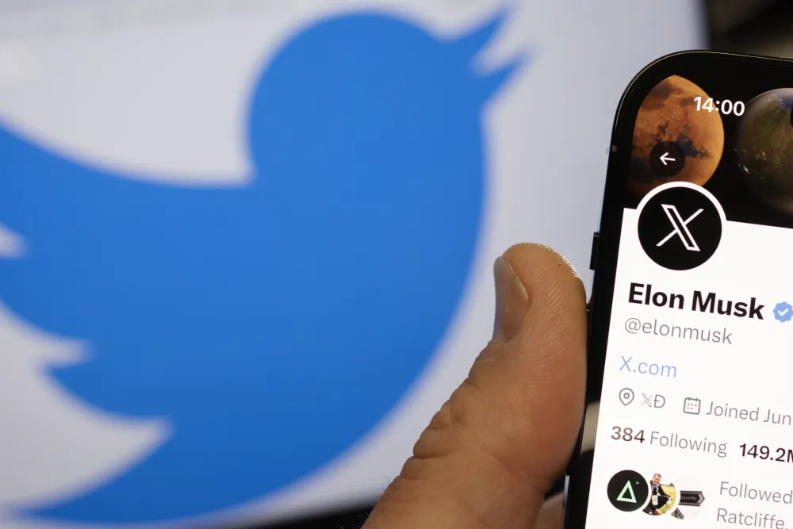
Problem-Focused
The Growing Problem of Misinformation on X (Twitter) and the need for Automated Detection.
INFORMATION ABOUT X(TWITTER):
Around 557 million users (2026 estimate),
237.8 million people use X (Twitter) daily (as per 2022 report)
Around 63.7% males and 36.3% females use X.
The average age of X users is between 25 and 34.
Source link https://www.demandsage.com/twitter-statistics

Slide 4
Real Life incidents caused by Misinformation Tweets.
Misinformation containing tweets that lead to severe consequences have increased tremendously on X (Twitter), a widely used social media platform.
Pizzagate child trafficking Conspiracy in US, leaded to real life violence.
United States election misinformation Tweets leaded to political unrest and consequence was United States Capitol attack on January 6, 2020.
COVID-19 fake cure Tweets (2020), misguided people to drink bleach, random medicines etc as a precautionary measure that reported several deaths.

Slide 5
Project Overview
This AI system detects whether a tweet is REAL,FAKE or Uncertain using Natural Language Processing (NLP) and Machine Learning (ML).
Key points:
Input: Tweet text
Output: Real / Fake / Uncertain
Tech: Python libraries, Naive Bayes Classifier, GUI

Slide 6
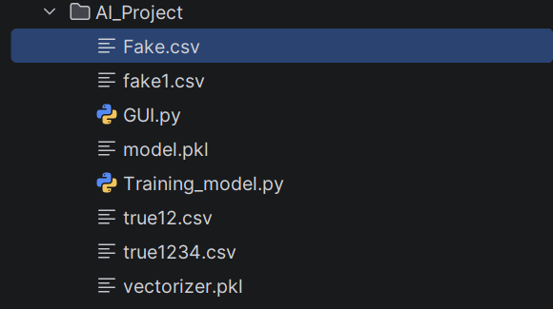
Libraries, Models and datasets used:
Datasets used:
Collection of real and fake tweet datasets used for training the model.
Real Tweet Dataset: Fake Tweet Dataset:
  1. true12.csv 3. Fake.csv
  2. true1234.csv 4. fake1.csv
Model Files
Trained Naive Bayes model and TF-IDF vectorizer .
Saved machine learning model (model.pkl)
Text converter (vectorizer.pkl) used for prediction.
GUI Application
Interactive interface for real-time tweet classification using Tinkter library.

Slide 7
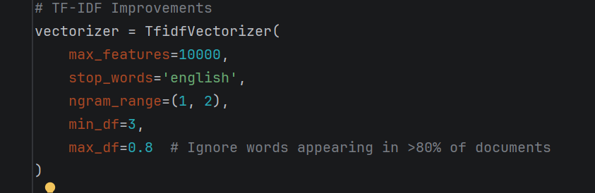
Feature Extraction (TF-IDF Model)
Tweets are converted into numerical vectors using TF-IDF (Term Frequency–Inverse Document Frequency), which helps the machine learning model understand and analyze text data.

Slide 8
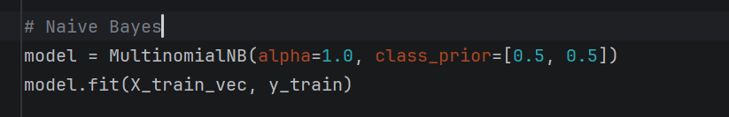
Naive Bayes Classifier
A Multinomial Naive Bayes classifier is used to train the model for detecting fake and real tweets based on text features.

Slide 9
Prediction Logic (Hybrid System)
Working Steps:
Input tweet is cleaned (removes URLs, symbols, extra text)
Text is converted into numerical form using TF-IDF vectorizer
Naive Bayes model calculates probability for Real and Fake
Difference between probabilities is calculated
If difference is small → result is UNCERTAIN
Otherwise → final result is REAL or FAKE

Slide 10
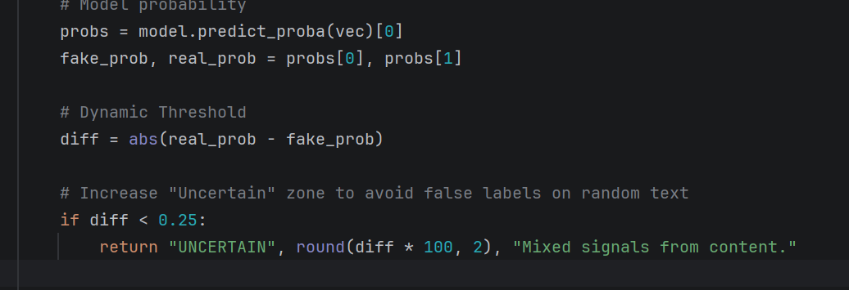

Slide 11
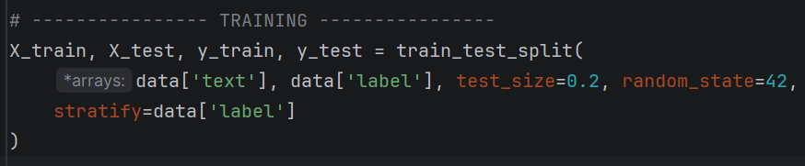
Train-Test Split
The dataset is split into training and testing sets to evaluate model performance.
80% training data
20% testing data

Slide 12
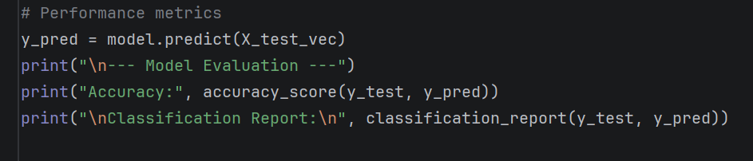
Model Evaluation
The performance of the model is evaluated using accuracy score and classification report on the test dataset.

Slide 13
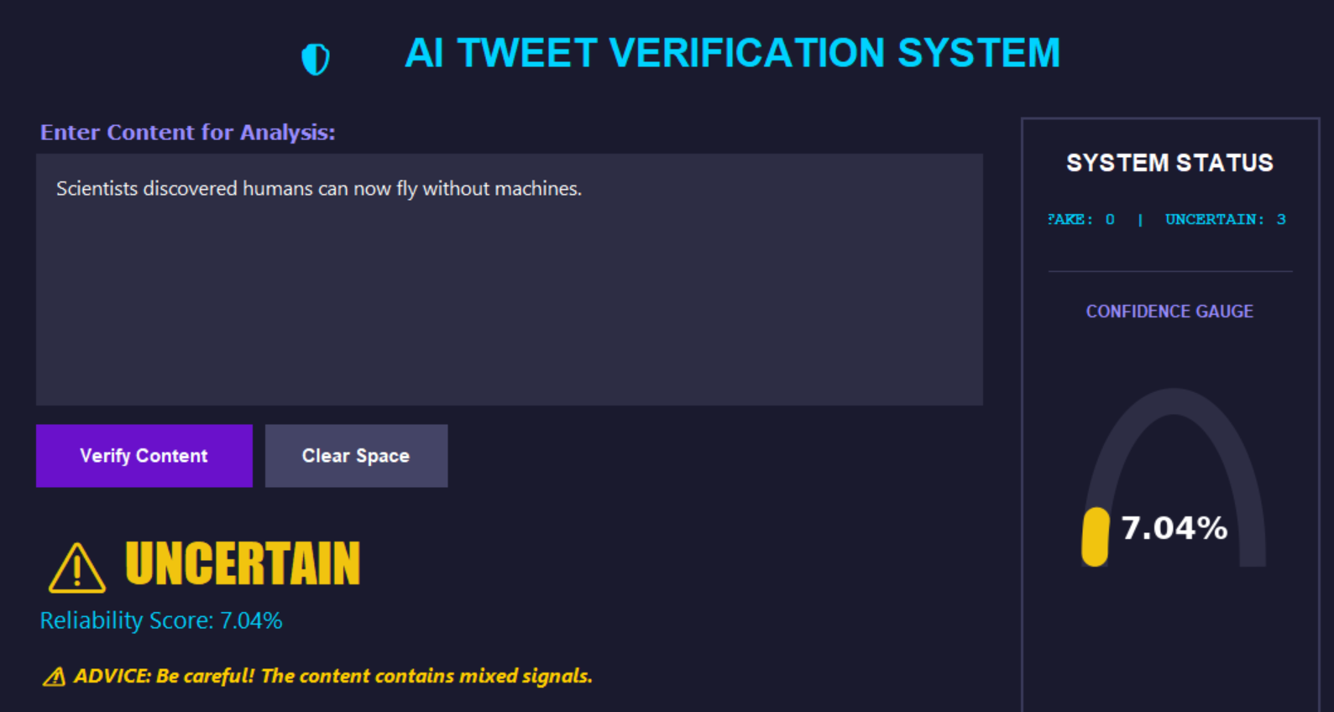
Sample Outputs:

Slide 14
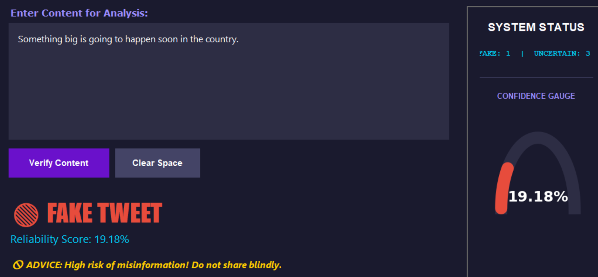
Sample Outputs

Slide 15
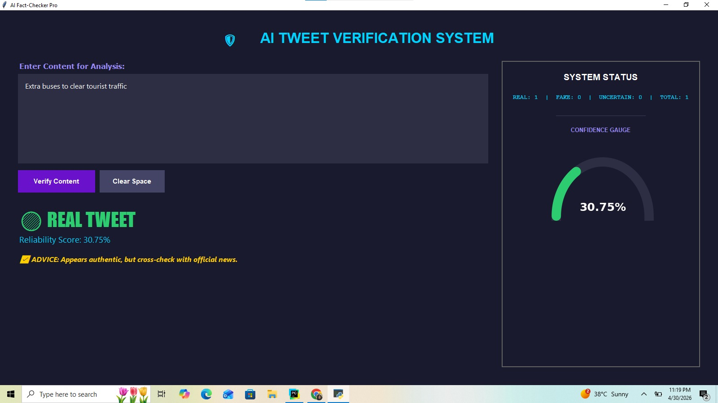
Sample Output:

Slide 16


